Slide 1


Deep Visual-Semantic Alignments for Generating Image Descriptions
석사과정 장명준

Slide 2
CONTENTS
1. Previous work
2. Idea
3. Model structure
4. Experiment
5. Result
6. Limitation

Slide 3
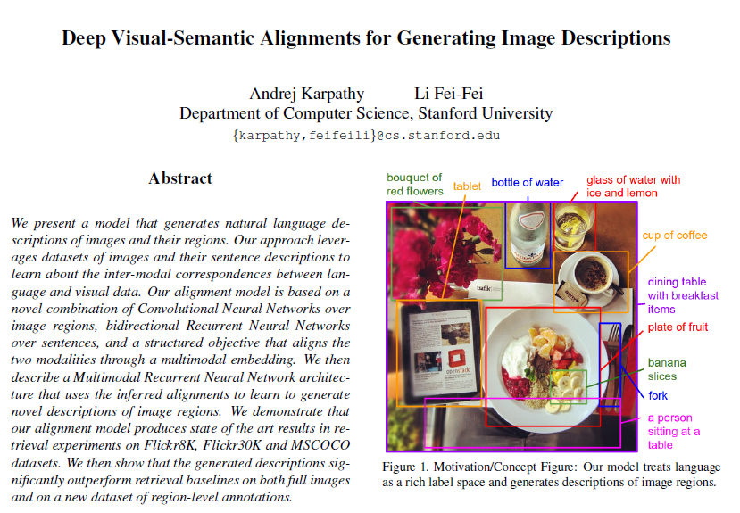

Slide 4
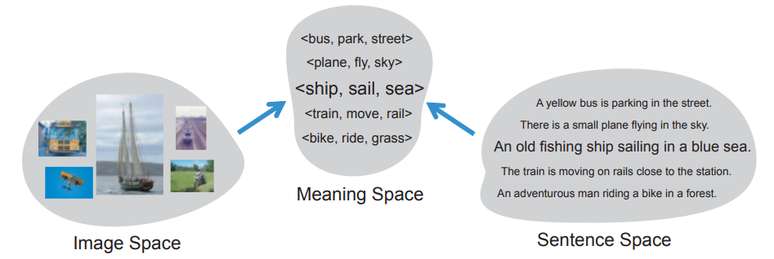
01
02
03
04
05
06
Reference
1) Previous work
Previous work 1.
- Farhadi et al, “Every Picture Tells a Story: Generating Sentences from Images”, In ECCV, 2010
- Assume there exist meaning space between Image & Sentence
- Meaning Space : <object, action, scene>
- Calculate similarity between Image-Meaning, Meaning-Sentence and mapping

Slide 5
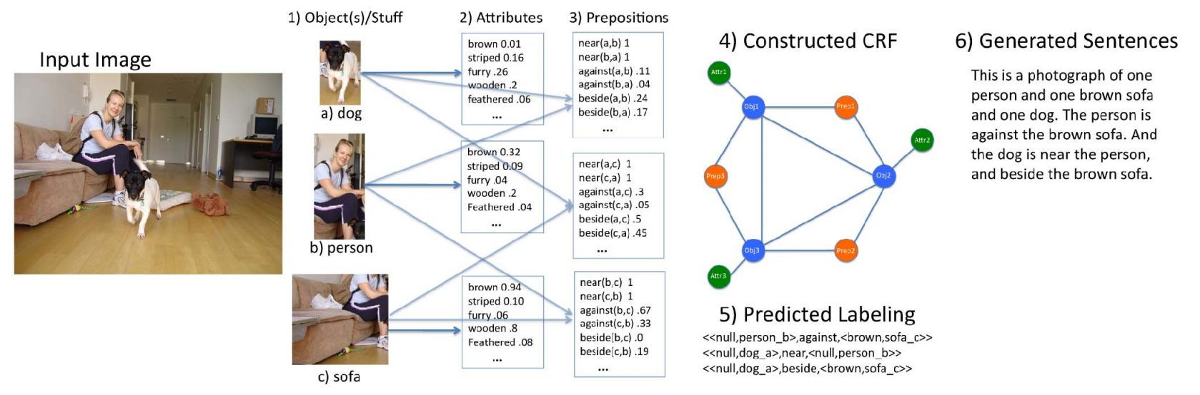
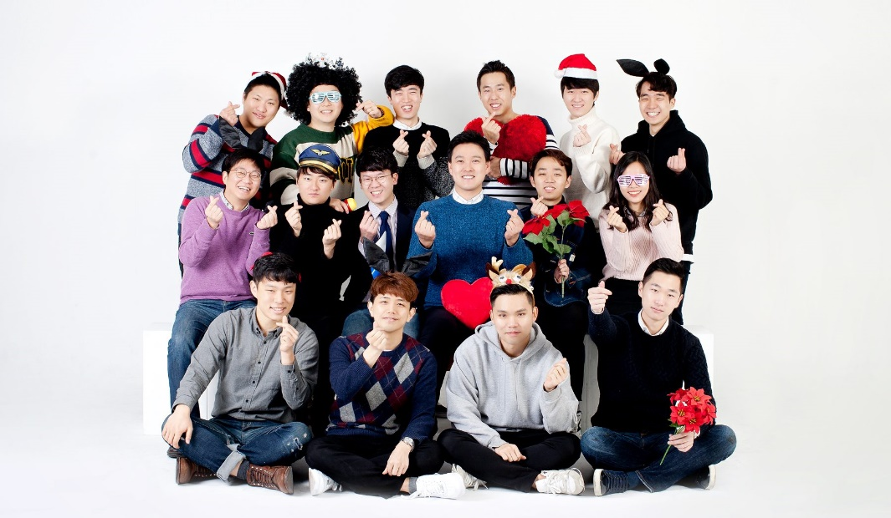
01
02
03
04
05
06
Reference
1) Previous work
Previous work 2.
- Kulkarni et al, “BabyTalk: Understanding and Generating Simple Image Descriptions”, In CVPR, 2011

Slide 6
01
02
03
04
05
06
Reference
1) Previous work
Problems
Not enough data set (work 1) : {Image – Meaning – Sentence}
Rely on hard-coded visual concept & sentence templates
Cause on the variety of model
These works focus on reducing complex visual scenes into a single sentence (which is unnecessary)

Slide 7
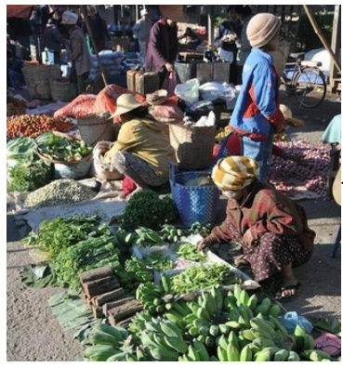
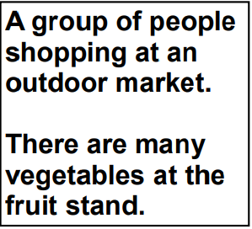
01
02
03
04
05
06
Reference
2) Idea
1) What we have to do?
- Reason about contents of images and their representation simultaneously
- Free of assumptions about specific hard-coded templates, rules or categories
- Model should rely on learning from training data
2) Training data
- There exist large quantities of image caption data
- These descriptions multiplex mentions of several entities whose locations in the images are unknown
3) Insight
- Contiguous segments of words correspond to some particular, but unknown location in the image
Use description as weakly label
Infer alignments of image location and corresponding description segment
Use to learn a generative model of descriptions

Slide 8
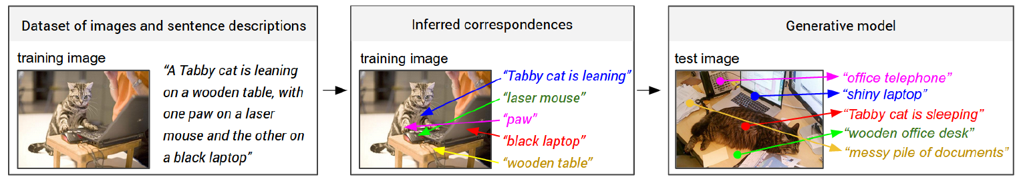

01
02
03
04
05
06
Reference
3) Model structure
1) Frame work
Data
Alignment model
Generative model
2) Learning to align visual and language data
2-1) Representing images
Detect objects in every image : By R-CNN, use top 19 detected locations + whole image
Represent each images(20) to 4096-dimensional vector by pre-trained CNN (softmax layer removed)
Embed 4096-dimensional vector to h-dimensional vector
$$v=W_{m}\left[{CNN}_{θ_{c}}\left(I_{b}\right)\right]+b_{m}$$
$$W_{m}:h×4096, b_{m}:h×1$$
$$Every images are represented as a set of h−dimensional vectors \{v_{i}|i=1,…,20\}$$

Slide 9
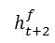
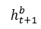
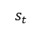
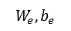
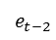
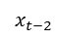
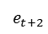
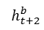
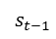
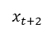
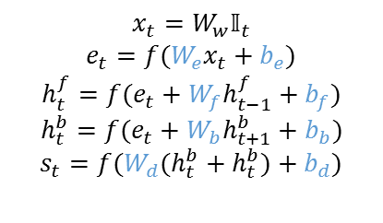
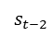
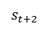
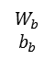
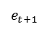
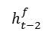
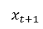
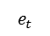
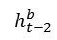
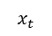
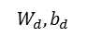
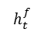
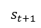
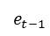
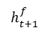
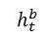
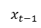
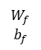
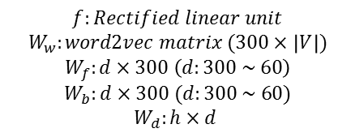
01
02
03
04
05
06
Reference
3) Model structure
2) Learning to align visual and language data
2-2) Representing sentences
Word in sentence should be embedded to the same h-dimensional vector to establish inter-modal relationship
Bi-directional Recurrent Neural Network
$$x_{t}=W_{w}𝕀_{t}$$
$$e_{t}=f(W_{e}x_{t}+b_{e})$$
$$h_{t}^{f}=f(e_{t}+W_{f}h_{t−1}^{f}+b_{f})$$
$$h_{t}^{b}=f(e_{t}+W_{b}h_{t+1}^{b}+b_{b})$$
$$s_{t}=f(W_{d}(h_{t}^{b}+h_{t}^{b})+b_{d})$$
$$s_{t−2}$$
$$s_{t−1}$$
$$s_{t}$$
$$s_{t+1}$$
$$s_{t+2}$$
$$W_{b}$$
$$b_{b}$$
$$W_{d},b_{d}$$
$$h_{t−2}^{b}$$
$$h_{t+1}^{b}$$
$$h_{t}^{b}$$
$$h_{t+1}^{b}$$
$$h_{t+2}^{b}$$
$$h_{t−2}^{f}$$
$$W_{f}$$
$$b_{f}$$
$$h_{t+1}^{f}$$
$$h_{t}^{f}$$
$$h_{t+1}^{f}$$
$$h_{t+2}^{f}$$
$$f:Rectified linear unit$$
$$W_{w}:word2vec matrix (300×\left|V\right|)$$
$$W_{f}:d×300 \left(d:300 \sim 60\right)$$
$$W_{b}:d×300 (d:300 \sim 60)$$
$$W_{d}:h×d$$
$$e_{t−2}$$
$$e_{t−1}$$
$$e_{t}$$
$$e_{t+1}$$
$$e_{t+2}$$
$$W_{e},b_{e}$$
$$x_{t−2}$$
$$x_{t−1}$$
$$x_{t}$$
$$x_{t+1}$$
$$x_{t+2}$$

Slide 10
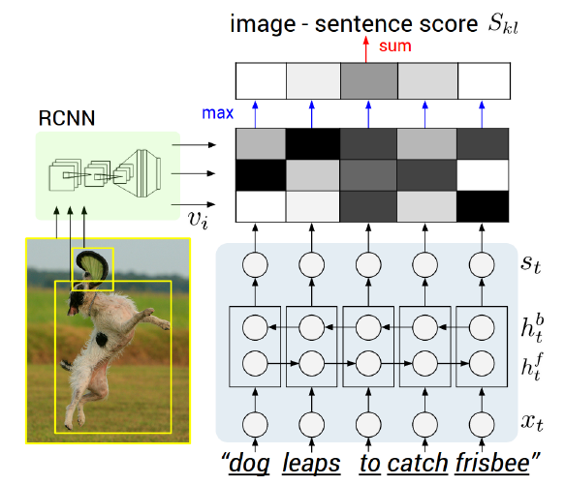
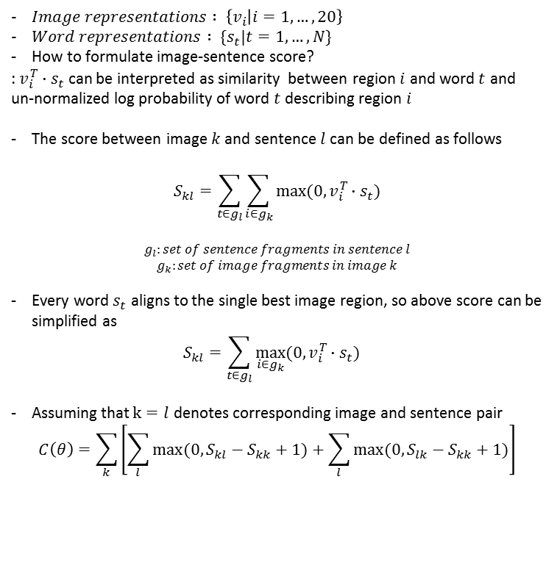
01
02
03
04
05
06
Reference
3) Model structure
2) Learning to align visual and language data
2-3) Alignment objective
$Image representations : \left\{v_{i} | i=1,…,20\right\}$
$Word representations : \{s_{t}|t=1,…,N\}$
How to formulate image-sentence score?
: $v_{i}^{T}∙s_{t}$ can be interpreted as similarity between region $i$ and word $t$ and
un-normalized log probability of word $t$ describing region $i$
The score between image $k$ and sentence $l$ can be defined as follows
$$S_{kl}=\sum_{t∈g_{l}}{\sum_{i∈g_{k}}{max⁡(0,v_{i}^{T}∙s_{t})}}$$
$$g_{l}:set of sentence fragments in sentence l$$
$$g_{k}:set of image fragments in image k$$
Every word $s_{t}$ aligns to the single best image region, so above score can be simplified as
$$S_{kl}=\sum_{t∈g_{l}}{\max_{i∈g_{k}}{(0,v_{i}^{T}∙s_{t})} }$$
Assuming that $k=l$ denotes corresponding image and sentence pair
$$C\left(θ\right)=\sum_{k}{\left[\sum_{l}{max⁡(0,S_{kl}−S_{kk}+1)}+\sum_{l}{max⁡(0,S_{lk}−S_{kk}+1)}\right]}$$
Rank images
Rank sentences
Problem : naïve solution assign each word independently to the highest-scoring region
leads to nearby words getting scattered to different regions

Slide 11
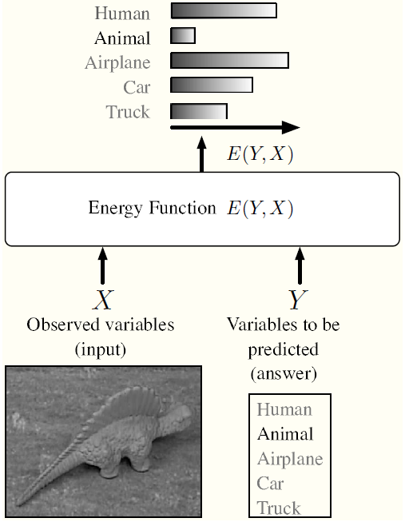

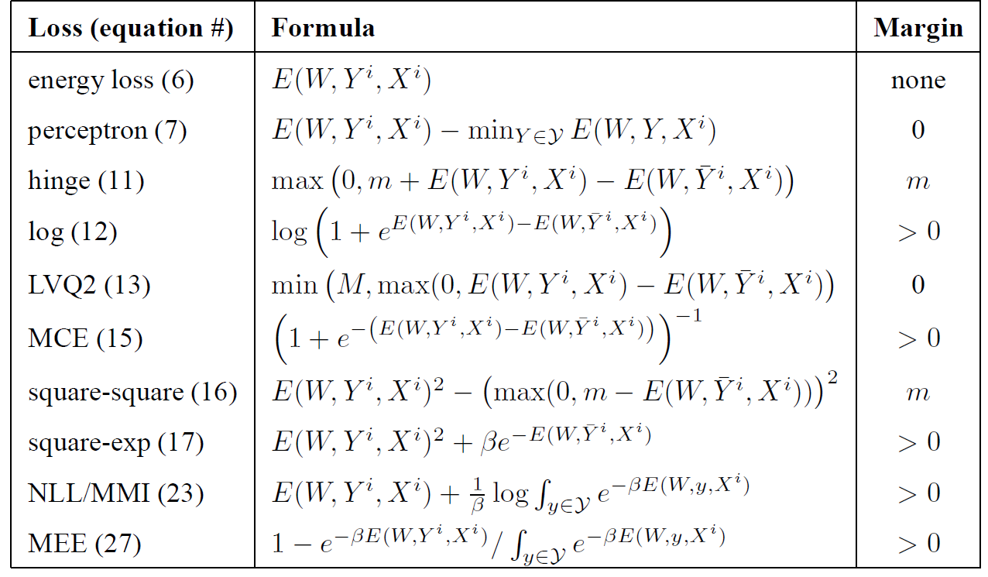
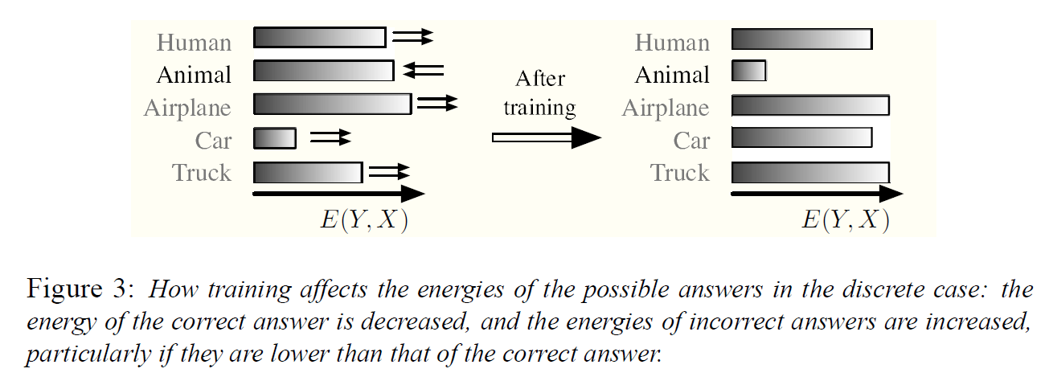
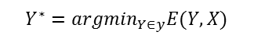
01
02
03
04
05
06
Reference
+α) Energy function
- Energy function : function that is used in model to measure compatibility between input variable X and output variable Y
Energy function: minimized by the inference process
Loss function: minimized by the learning process
$$Y^{∗}={argmin}_{Y∈y}E(Y,X)$$
- Learning Parameters of Energy function
Needs to define Loss function
Result of learning
Yann LeCun et.al, A Tutorial on Energy-Based Learning, 2006

Slide 12
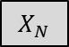
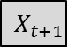

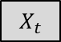
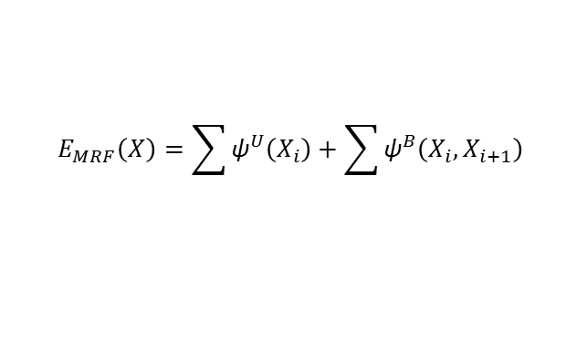
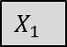
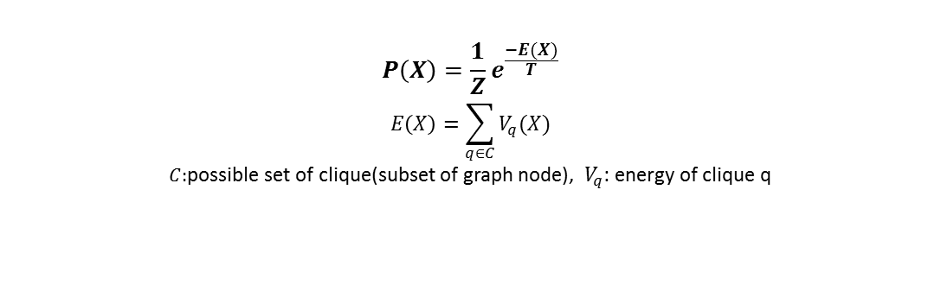
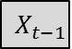
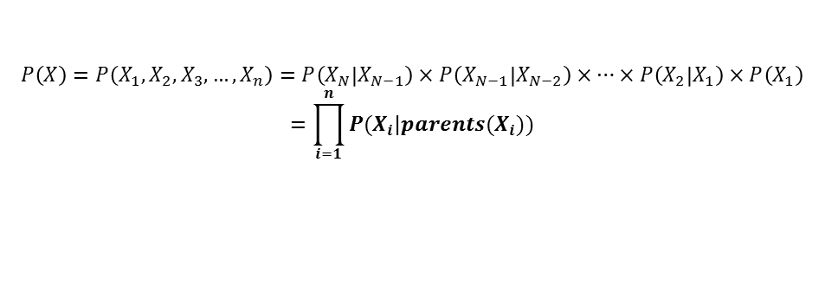
01
02
03
04
05
06
Reference
+α) Markov Random Field(MRF)
Modeling joint probability $P\left(X\right)=P(X_{1},X_{2},X_{3},…,X_{n})$ which satisfy Markov property
Markov Property
$$\left\{X_{t}\right\} is said to have Markov property if P\left(X_{t+1} | X_{0},X_{1},…,X_{t}\right)=P\left(X_{t+1} | X_{t}\right) for t=0, 1, …$$
$$→future only depends upon the present state$$
$$X_{1}$$
$$X_{t−1}$$
$$X_{t}$$
$$X_{t+1}$$
$$X_{N}$$
$$P\left(X\right)=P\left(X_{1},X_{2},X_{3},…,X_{n}\right)=P\left(X_{N} | X_{N−1}\right)×P\left(X_{N−1} | X_{N−2}\right)×…×P\left(X_{2} | X_{1}\right)×P\left(X_{1}\right)$$
$$=\prod_{i=1}^{n}{P(X_{i}|parents(X_{i}))}$$
Problem : We can’t calculate exact P(X)
Instead, we use gibbs distribution to calculate P(X)
$$P\left(X\right)=\frac{1}{Z}e^{\frac{−E(X)}{T}}$$
$$E\left(X\right)=\sum_{q∈C}{V_{q}(X)}$$
$C:$possible set of clique(subset of graph node), $V_{q}$: energy of clique q
$$E_{MRF}\left(X\right)=\sum{{\text{ψ}}^{U}\left(X_{i}\right)}+\sum{{\text{ψ}}^{B}\left(X_{i},X_{i+1}\right) }$$
Frederick S. Hillier, Gerald J. Lieberman, “Introduction to Operations Research”, p.725
Andrew Blake, Pushmeet Kohli, “Introduction to Markov Random Fields”

Slide 13














01
02
03
04
05
06
Reference
3) Model structure
2) Learning to align visual and language data
2-3) Markov Random Field(MRF)
Given a sentence with N words and an image with M bounding boxes, introduce latent alignment variable $a$
$a_{j}=\left\{1,2,…,M\right\} for j=1,2,…,N$
$$a_{1}$$
$$a_{j}$$
$$a_{j+1}$$
$$a_{j+2}$$
$$a_{N}$$
$$w_{1}$$
$$w_{j}$$
$$w_{j+1}$$
$$w_{j+2}$$
$$w_{N}$$
Should be….
$${\text{ψ}}_{j}^{U}\left(a_{j}=t\right)=−v_{t}^{T}s_{j},$$
$$β<0$$

Slide 14

01
02
03
04
05
06
Reference
3) Model structure
2) Learning to align visual and language data
2-3) Markov Random Field(MRF)

Slide 15











01
02
03
04
05
06
Reference
3) Model structure
3) Generative model
3-1) Long-Short Term Memory(LSTM)
Training
Word dictionary : add special “START”, “END” token
$$b_{v}=W_{hi}[{CNN}_{θ_{c}}(I)]$$
$$h_{t}=f(W_{hx}x_{t}+W_{hh}h_{t−1}+b_{h}+I(t=1)⊙b_{v})$$
$$y_{t}=softmax(W_{oh}x_{t}+b_{o})$$
Testing
Word Dist
END
$$s_{t}$$
sampling
sampling
$$W_{oh}$$
$$W_{hh}$$
$$h_{t}$$
$${CNN}_{θ_{c}}$$
$$W_{hi}$$
$$W_{hx}$$
$$x_{t}$$
STRAT

Slide 16















01
02
03
04
05
06
Reference
3) Model structure
3) Generative model
3-1) Long-Short Term Memory(LSTM)
Testing
Sampling
$$p_{1}$$ | $$p_{2}$$ | $$p_{3}$$ | $$p_{4}$$ | … | … | $$p_{N}$$
Sampling word
Beam Search
$$w_{7}$$
$$P=P{(w}_{1})×P{(w}_{5})×P{(w}_{7})$$
$$w_{5}$$
$$w_{2}$$
$$P=P{(w}_{1})×P{(w}_{5})×P{(w}_{2})$$
$$w_{1}$$
Beam size: 2
$$w_{2}$$
$$P=P{(w}_{1})×P{(w}_{3})×P{(w}_{2})$$
$$w_{3}$$
$$w_{4}$$
$$P=P{(w}_{1})×P{(w}_{3})×P{(w}_{4})$$
$$W_{1}$$
$$W_{2}$$
$$W_{3}$$

Slide 17
01
02
03
04
05
06
Reference
4) Experiment
1. Data set
Data set | # of data | Training | Validation | Test
Flickr8K | 8,000 | 7,000 | 1,000 | 1,000
Flickr30K | 31,000 | 30,000 | 1,000 | 1,000
MSCOCO | 123,000 | 113,000 | 5,000 | 5,000
2. Preprocessing
Convert all sentences to lower-case
Discard non-alphanumeric characters
Filter words that occur at least 5 times in the training set
 | Flickr8K | Flickr30K | MSCOCO
# of words | 2,538 | 7,414 | 8,791

Slide 18



01
02
03
04
05
06
Reference
5) Result
1. Region prediction

Slide 19


01
02
03
04
05
06
Reference
5) Result
2. Description generation

Slide 20



01
02
03
04
05
06
Reference
5) Result
3. Magnitude modulation
We compute the image-sentence similarity as
$$S_{kl}=\sum_{t∈g_{l}}{\max_{i∈g_{k}}{(0,v_{i}^{T}∙s_{t})} }$$
Visually discriminative words tend to have higher magnitude in the embedding space
Stopwords are mapped near the origin
Image regions containing discriminative entities are assigned vectors of higher magnitudes
Flicker30K test set regions with high vector magnitude
Magnitudes of vectors for words in Flicker30K

Slide 21
01
02
03
04
05
06
Reference
6) Limitation
1. No Context
The prediction does not include context outside of each region
2. Inefficient
We must forward every region independently
3. Not end-to-end
There are two models trained separately

Slide 22


01
02
03
04
05
06
Reference
6) Limitation

Slide 23


